Slide 1
UNIT I - Electrostatics, Magnetostatics and Electrodynamics
Electric Charge - Coulomb’s Law
Electric field
Electric Dipole
Calculating Electric field from Coulomb’s Law
Gauss’s Law - Using Symmetry to Calculate Electric field
Divergence and curl of electrostatic field
Electrostatic Potential
Computing the Electric Field from the Potential
Laplace’s and Poisson’s equations for electrostatic potential
Lorentz force, Ampere’s law, Faraday’s law and Lenz’s law
Maxwell’s equations

Slide 2
Finding the Electric Field using Gauss’s law

Slide 3
Objective
To calculate Electric field through Gauss’s Law
Gauss’ law relates the electric fields at points on a closed Gaussian surface and the net charge enclosed by that surface
Gauss’ law is equivalent to Coulomb’s law but expressed in a different form with new concepts
Gauss’s law helps us to understand the behavior of electric fields inside the conductors and the distribution of electric charge placed inside a conductor

Slide 4

Calculation $\vec{E}$of by using symmetry
For certain charge distributions involving symmetry, the electric field can be found using Gauss’ law
Gauss’ law considers a hypothetical (imaginary) closed surface enclosing the charge distribution.
This Gaussian surface (GS), can have any shape, but the shape that minimizes our calculations of the electric field is one that mimics the symmetry of the charge distribution.
For example, if the charge is spread uniformly over a sphere (see Fig. 1).
Enclose the sphere with a spherical Gaussian surface
Electric field vectors are of uniform magnitude and point radially outward at all surface points
Hence concludes that the positive distribution of charge must lie within the surface and have spherical symmetry.
Fig. 1 A spherical Gaussian surface.

Slide 5
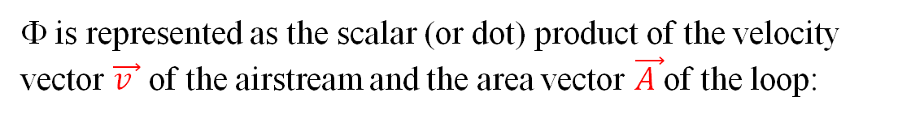
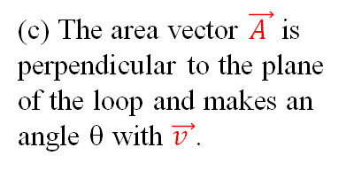
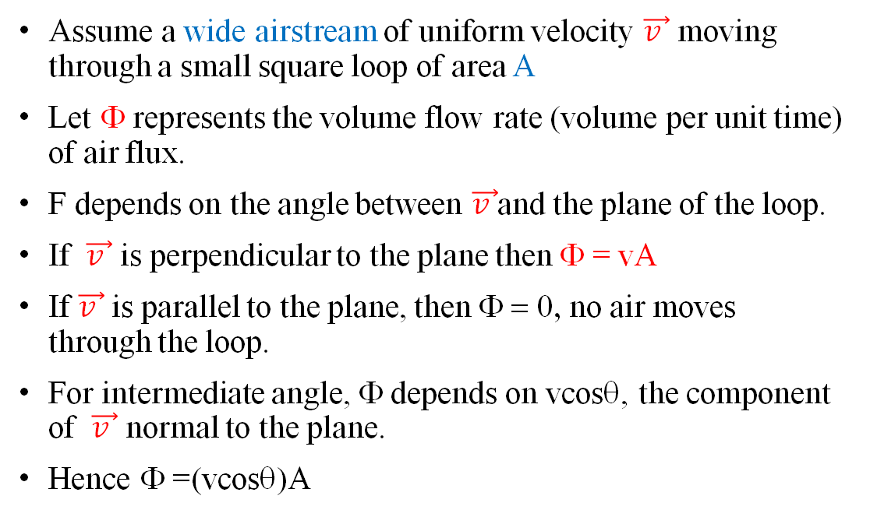

Flux
Assume a wide airstream of uniform velocity $\vec{v }$ moving through a small square loop of area A
Let Φ represents the volume flow rate (volume per unit time) of air flux.
F depends on the angle between $\vec{v }$and the plane of the loop.
If $\vec{v }$ is perpendicular to the plane then Φ = vA
If $\vec{v }$ is parallel to the plane, then Φ = 0, no air moves through the loop.
For intermediate angle, Φ depends on vcosθ, the component of $\vec{v }$ normal to the plane.
Hence Φ =(vcosθ)A
(a) A uniform airstream of velocity is perpendicular to the plane of a square loop of area A.
(b) The component of perpendicular to the plane of the loop is v cosθ, where θ is the angle between and a normal to the plane
Representing flux in terms of vectors
Φ is represented as the scalar (or dot) product of the velocity vector $\vec{v }$ of the airstream and the area vector $\vec{A }$of the loop:
(c) The area vector $\vec{A }$ is perpendicular to the plane of the loop and makes an angle θ with $\vec{v }$.
(d) The velocity field intercepted by the area of the loop.
where θ is the angle between $\vec{A }$ and $\vec{v }$

Slide 6
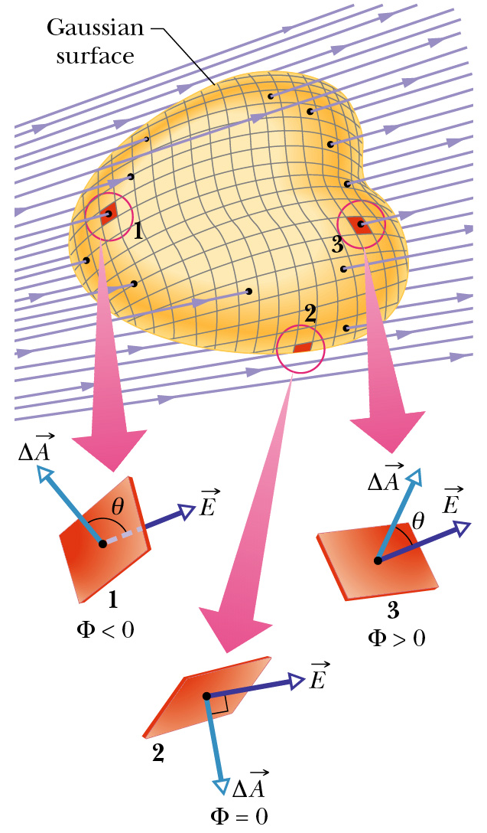
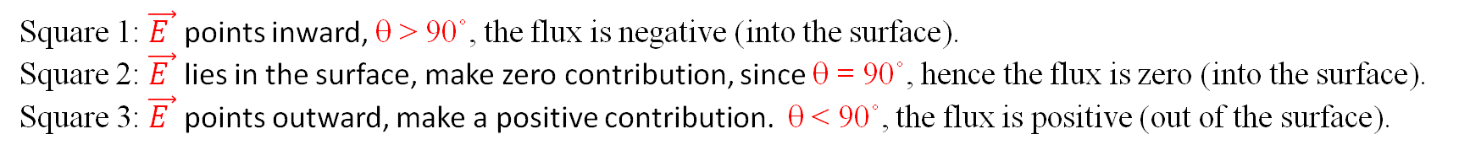
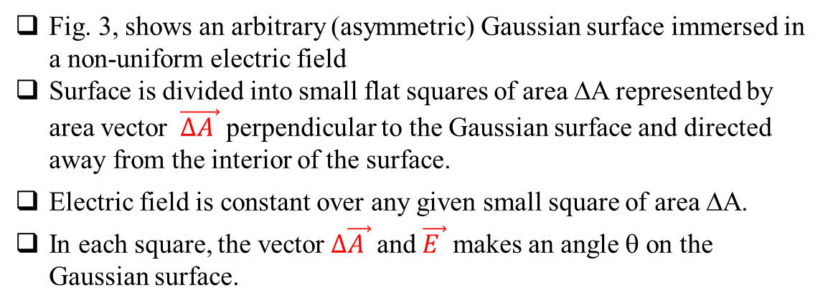
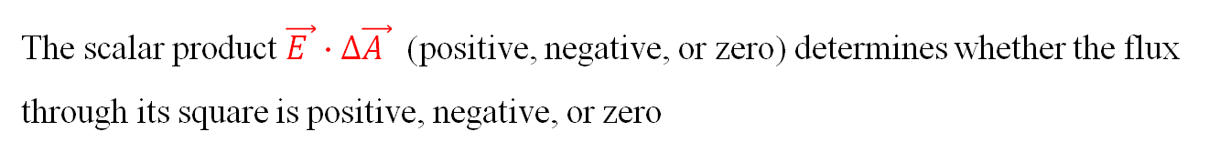
Flux of an Electric Field
Fig. 3, shows an arbitrary (asymmetric) Gaussian surface immersed in a non-uniform electric field
Surface is divided into small flat squares of area ΔA represented by area vector $\vec{∆A }$ perpendicular to the Gaussian surface and directed away from the interior of the surface.
Electric field is constant over any given small square of area ΔA.
In each square, the vector$∆\vec{A }$ and $\vec{E }$ makes an angle θ on the Gaussian surface.
The flux Φ of the electric field for the Gaussian surface is given as:
The scalar product $\vec{E }∙∆\vec{A }$ (positive, negative, or zero) determines whether the flux through its square is positive, negative, or zero
Square 1: $\vec{E }$ points inward, θ > 90˚, the flux is negative (into the surface).
Square 2: $\vec{E }$ lies in the surface, make zero contribution, since θ = 90˚, hence the flux is zero (into the surface).
Square 3: $\vec{E }$ points outward, make a positive contribution. θ < 90˚, the flux is positive (out of the surface).

Slide 7
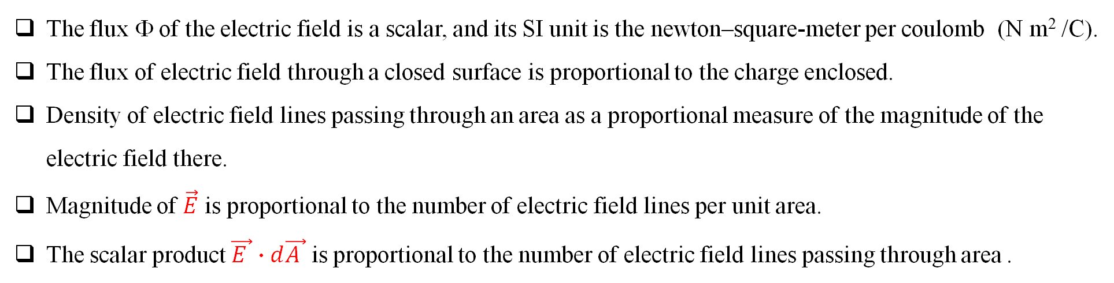
For surface with continuous charge distribution, the electric flux can be represented as:
The symbol ∮ has a little circle to indicate that the integral is over a closed surface.
The closed surface is called a gaussian surface, because such surfaces are used by Gauss’ Law, which states that:
The electric flux Φ through a Gaussian surface is proportional to the net number of electric field lines passing through that surface.
The flux Φ of the electric field is a scalar, and its SI unit is the newton–square-meter per coulomb (N m² /C).
The flux of electric field through a closed surface is proportional to the charge enclosed.
Density of electric field lines passing through an area as a proportional measure of the magnitude of the electric field there.
Magnitude of $\vec{E}$ is proportional to the number of electric field lines per unit area.
The scalar product $\vec{E }∙d\vec{A }$ is proportional to the number of electric field lines passing through area .

Slide 8
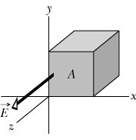
The figure below shows a Gaussian cube of face area A immersed in a uniform electric field E that has the positive direction of the z axis.
In terms of E and A, determine the flux flowing through:
(a) the front face (xy plane)
(b) the rear face
(c) the top face
(d) the whole cube
Φ = +EA
Φ = –EA
Φ = 0
Φ = 0

Slide 9
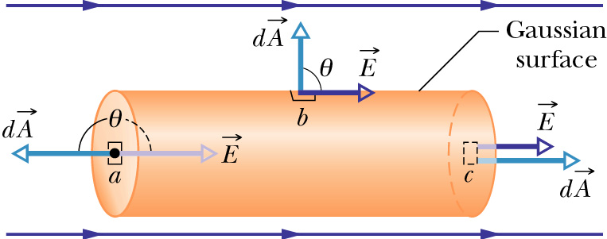
Gaussian Surface: Cylinder
The figure shows a Gaussian surface in the form of a cylinder of radius R immersed in a uniform electric field E, with the cylinder axis parallel to the field. What is the flux Φ of the electric field through this closed surface?
left cap
right cap
cylindrical surface
zero net flux

Slide 10
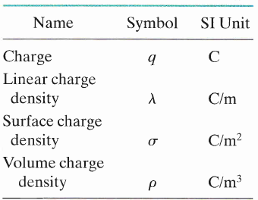
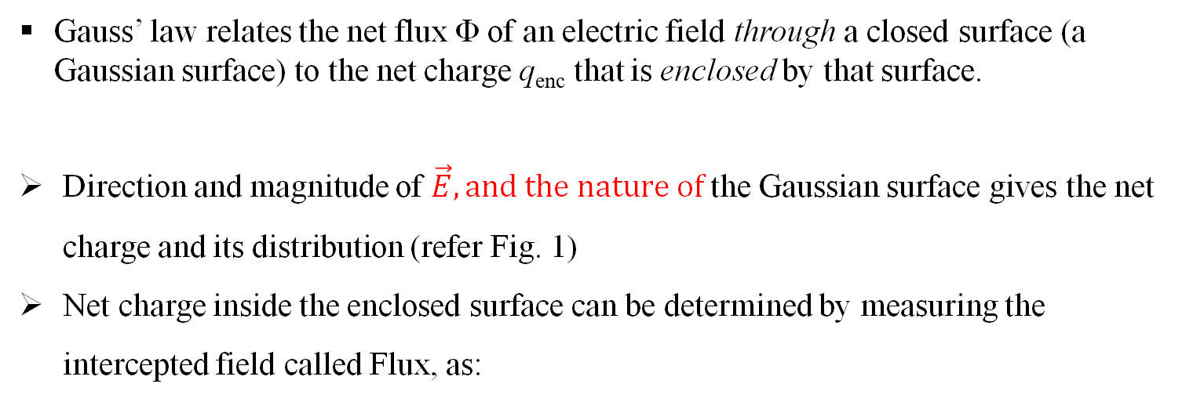
Gauss’ law
Gauss’ law relates the net flux Φ of an electric field through a closed surface (a Gaussian surface) to the net charge q_{enc} that is enclosed by that surface.
Direction and magnitude of $\vec{E}, and the nature of$the Gaussian surface gives the net charge and its distribution (refer Fig. 1)
Net charge inside the enclosed surface can be determined by measuring the intercepted field called Flux, as:
Fig. 1 A spherical Gaussian surface.
in vacuum
The net charge q_{enc} is the algebraic sum of all the enclosed positive and negative charges, and it can be positive, negative, or zero.
If q_{enc} is positive, the net flux is outward;
if q_{enc} is negative, the net flux is inward.
Charge outside the surface, no matter how large or how close it may be, is not included in the term q_{enc} in Gauss’ law.

Slide 11
Consider a dipole with equal positive and negative charges.
Imagine four surfaces S₁, S₂, S₃, S₄, as shown.
S₁: Electric field is outward for all points → flux is positive → enclosed charge is positive
S₂: Electric field is inward for all points → flux is negative → enclosed charge is negative
S₃: No charge enclosed
S₄: Net charge enclosed is equal to zero, the field lines leaving the surface are as many as the field lines entering it
Two point charges, equal in magnitude but opposite in sign, and the field lines that represent their net electric field. Four Gaussian surfaces are shown in cross section.
Note: When an enormous charge Q is brought up close to surface S4.
The pattern of the field lines would certainly change, but the net flux for each of the four Gaussian surfaces would not change.

Slide 12
